Slide 1
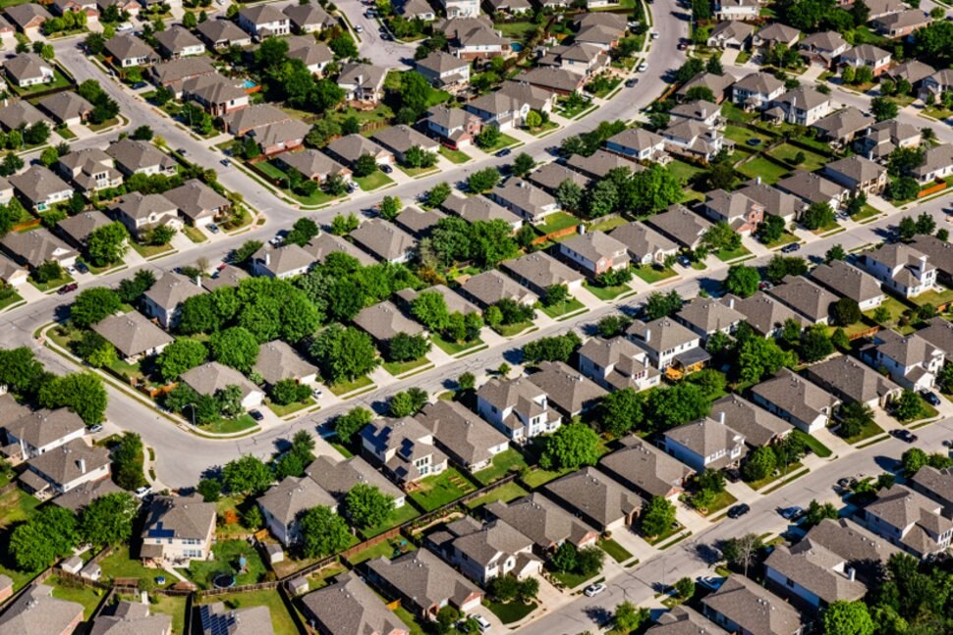
King County House price Analysis
Olaide Kashimawo
Notes:
NOTE:
To change the image on this slide, select the picture and delete it. Then click the Pictures icon in the placeholder to insert your own image.

Slide 2

Overview and Business Understanding
The purpose of this project is to inform you the Real Estate Stakeholders what affects the values of homes in King County House Sale using a linear regression model.

Slide 3
King County House Price Data(2014-2015)
21,613 House Sales with 21 features
Average House price:$540,000
Average lot size: 21,000 Square feet
Average Bedrooms: 3 -7
Location: King County WA
Model used : Linear Regression
Bedroom
Bathroom
Waterfront
Square feet living
Longitude and Latitude

Slide 4

EXPLORATORY DATA ANALYSIS

Slide 5


Factors to look at
Does the square feet living have any impact on house prices?
Does the grade have any impact on house prices?
Are waterfront houses priced higher?
Does the number of bedrooms have any impact on house prices?

Slide 6
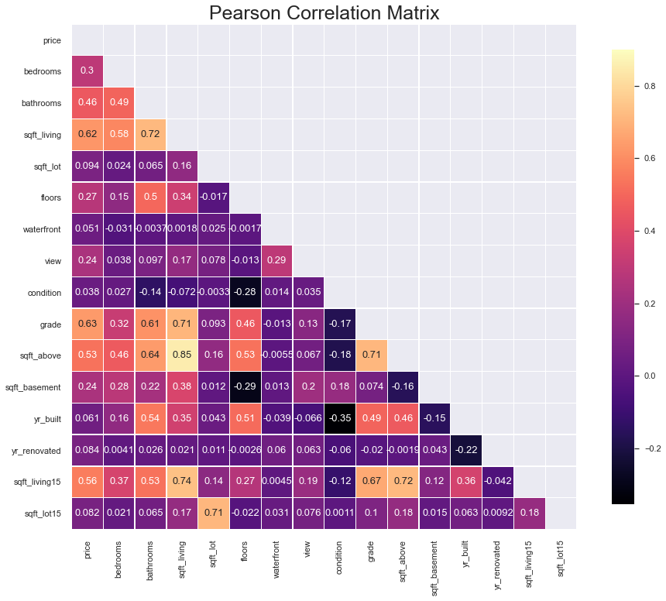
The most significant influence on house prices
Square feet living
Waterfront
Grade
Square feet above

Slide 7
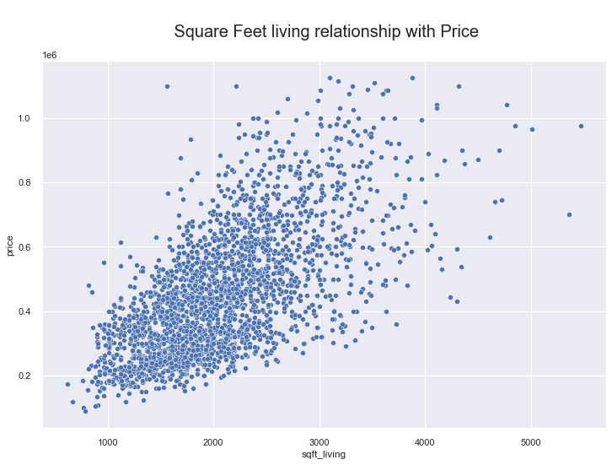
The value of the house increases as we increase the square feet living of the house indicating is positively correlated.

Slide 8
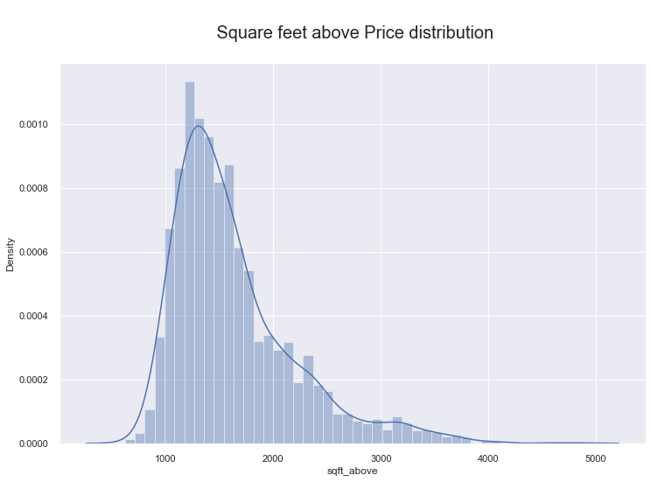

Slide 9
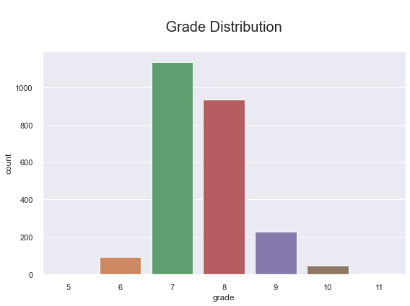
The King’s County grading system shows the grading between the number 1 to 11 with an average of 7 to 8

Slide 10
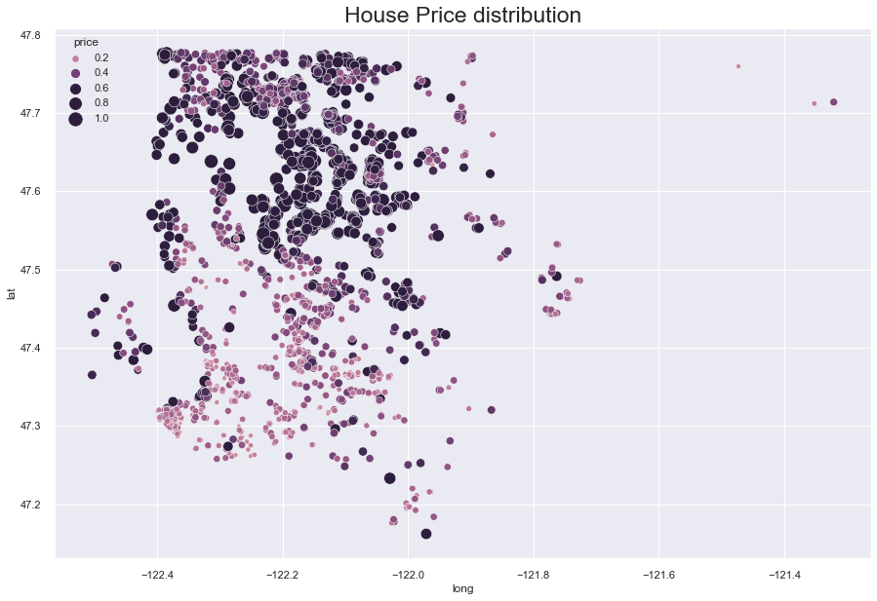
Location Distribution: House price distribution show houses closer to waterfront has higher prices

Slide 11
Result
Increase in R-squared 0.696 to 0.764 using polynomial regression
Decrease in RMSE : $ 151414.98 to 104799.97
The projections will need to be double-checked to verify they make sense given what is known about the house
The RMSE is 104799.97, which means that the standard deviation of the unexplained variance (error) is on average $104799.97.

Slide 12
Recommendation
Square Foot Living: More square feet means a higher value for the house. Our model shows that when the square feet is larger, the higher the price.
High Grade: Properties with excellent grades get a better price and are considered of a high value compared to homes with lower grades.
Location are Key: When a home sits on the waterfront, its value is higher than the same property without a waterfront view. It's important to recognize this fact.

Slide 13
Next Step
Future work would need more insight into how zip code influenced house prices; are the number of houses in specific zip codes have higher sales prices?
To determine the validity of the data further, I will use the polynomial regression model.

Slide 14
Thank you
GitHub: github.com/olaidekashimawo/
LinkedIn: linkedin.com/in/olaide-Kashimawo
Email:goldprint3@outlook.com

